Slide 1

Welcome North Texas ISA Section Members
ISA North Texas Section
Planning Meeting

Slide 2

Meeting Lunch Sponsor
Big “Thank You” to our lunch sponsor: EADS

Slide 3
Call to Order and Introductions
Provide
  Name
  Company
  City

Slide 4
Membership Report
241 Active Members
13 Active Grace Members (Membership just lapsed)
Membership Chair: Kamran Khan, Carollo Engineers
New Member Introduction Email
Lapsed Member Renewal Email

Slide 5
ISA Membership Benefits
Technical Resources
Discounts on ISA resources, training, and conferences
Subscription to InTech magazine
Unlimited online viewing of ISA standards
Unlimited access to archived ISA web seminars
Unlimited downloads of ISA Technical Papers
Professional Network
Access to local professionals via ISA Sections
Connections to peers via ISA Technical Divisions
Industry thought leader discussions via ISA Online Communities
Leadership Skills
Leadership Development Training
Hundreds of Volunteer Roles
Publishing, Teaching, and Presenting Opportunities
ISA Honors and Awards, Recognition Programs
ISA Membership: Your All-Access Pass
Notes:
Here is a breakdown of ISA’s main membership benefits: technical resources, professional networking and developing leadership skills.

Slide 6
ISA Membership Benefits
Continued on next slide
Notes:
Some additional membership benefits are listed here. ISA insights informs members about ISA-related events and news. ISA members can also enjoy discounts on insurance, travel and even products from Office Depot.

Slide 7
Notes:
Some additional membership benefits are listed here. ISA insights informs members about ISA-related events and news. ISA members can also enjoy discounts on insurance, travel and even products from Office Depot.

Slide 8
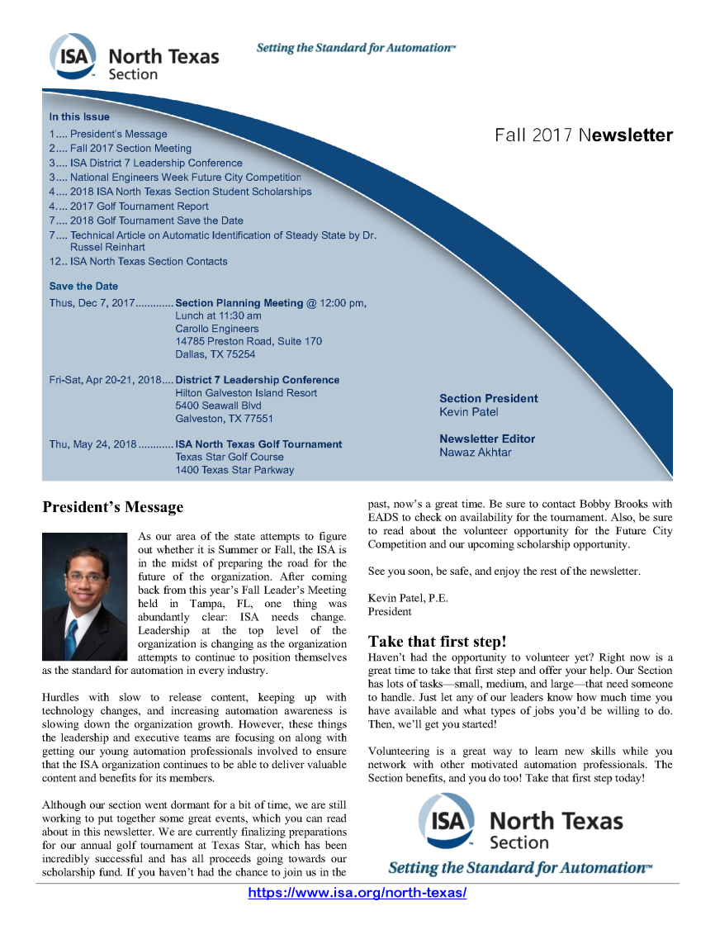
Newsletter Report
Method to communicate to our members
Fall 2017 newsletter sent out
Call for articles
Call for advertising

Slide 9

DFW Future City Competition
ISA Sponsorship of “Excellence in Automation”
Volunteers needed (Patel, Brooks, Khan have offered)
First judging event takes place on January 27, 2018
Future City is one of the nation’s leading engineering education programs and has received national recognition and acclaim for its role in encouraging middle schoolers to develop their interest in science, technology, engineering and math (STEM).

Slide 10

2018 Technical Seminar Planning
Ideas on topics or volunteers or we can get an ISA speaker
Select date for next seminar
?
USER
TRAINING

Slide 11

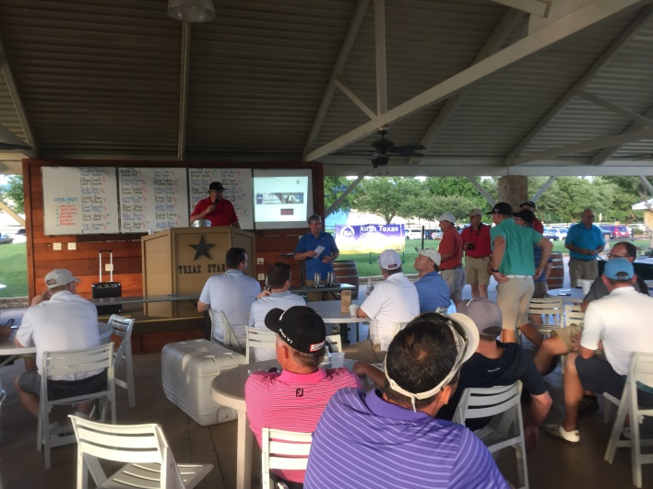
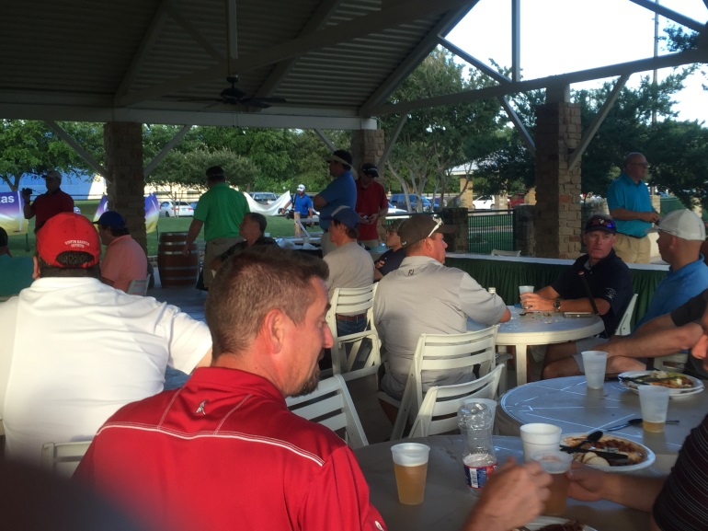
2018 Golf Tournament Planning
Date selected
Location selected
Details
WHEN: Thursday, May 24, 2018 @ 1:00 pm
WHERE: Texas Star Golf Course
1400 Texas Star Parkway
Euless, Texas 76040

Slide 12
2018 Plant Tour Planning
Ideas for possible plant tour
Select date for plant tour
?

Slide 13
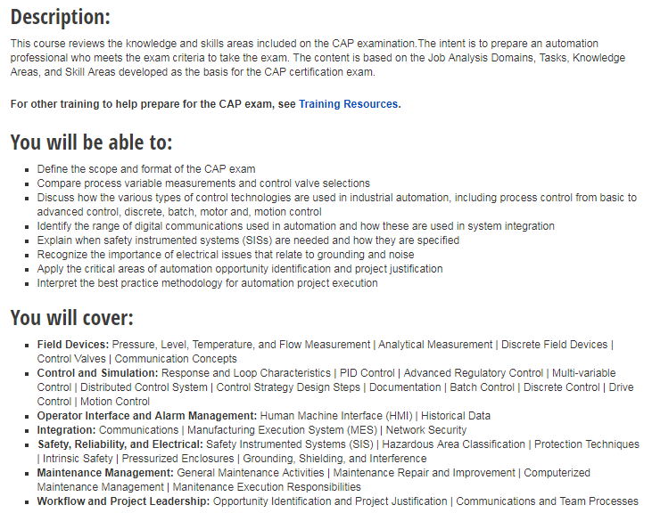

CAP Training
Certified Automation Professional (CAP)
Manoj working on details to host a training course
Location and contract status
https://www.isa.org/training-certifications/isa-training/instructor-led/course-descriptions/ec00/

Slide 14
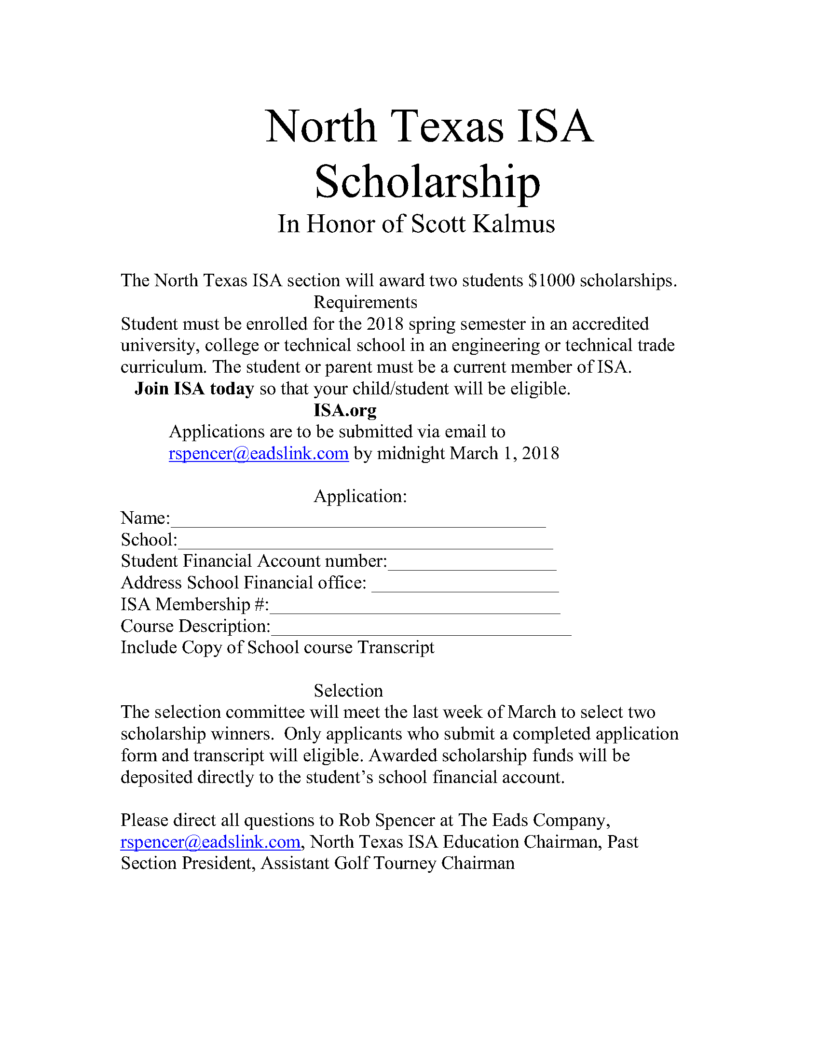
Student Scholarship
2 students are awarded $1000 scholarships
Submissions due on March 1, 2018
Email submissions to rspencer@eadslink.com

Slide 15

Next Meeting
Thursday, March 8, 2018

